Slide 1
AUTOMATIC LICENSE NUMBER PLATE RECOGNITION SYSTEM PROJECT GUIDE: GANGA KRISHNAN.G NATHEERA BEEVI M 20MCA418

Slide 2
CONTENTS
INTRODUCTION
RELATED WORKS
GAP IDENTIFIED
PROBLEM STATEMENT
OBJECTIVES
METHODOLOGY
RESULT AND DISCUSSION
CONCLUSION AND FUTURE ENHANCEMENT
REFERENCE
SCREENSHOT

Slide 3
INTRODUCTION
A Number Plate is a metal or plastic plate attached to a vehicle for official identification purposes.
The License Plates are placed on the front and back of the vehicle.
Automatic License Plate Recognition (ALPR) or ANPR is the technology responsible for reading the License plates of a vehicle in an image or a video sequence.

Slide 4
ANPR technology is contributing towards intelligent transportation systems and is eliminating the need of human intervention.
From the captured image or footage, ANPR detects license plate region.
In this project, four algorithms - CNN, VGG16, VGG19, and Yolov3 are used to detect the license plate and comparing the accuracies achieved.

Slide 5
RELATED WORKS

Slide 6
SL.NO | TITLE | YEAR OF PUBLISHING | PROS | CONS
1 | Chou, J.S.; Liu, C.H. Automated Sensing System for Real-Time Recognition of Trucks in River Dredging Areas Using Computer Vision and Convolutional Deep Learning,IEEE. | 2021 | Real-time detection ROI Based filtering | Format dependent

Slide 7
SL.NO | TITLE | YEAR OF PUBLISHING | PROS | CONS
2 | Croce, A.I.; Musolino, G.; Rindone, C.; Vitetta, A Route and Path Choices of Freight Vehicles: A Case Study with Floating Car Data. Sustainability,IEEE | 2020 | Real time detection | Higher processing time, cost and power for higher resolution images
3 | Singh, V.; Srivastava, A.; Kumar, S.; Ghosh, R. A Structural Feature Based Automatic Vehicle Classification System at Toll Plaza,IEEE | 2020 | Real time detection Region of Interest (ROI) based filtering | Format dependent

Slide 8
SL.NO | TITLE | YEAR OF PUBLISHING | PROS | CONS
4 | Sasi, A.; Sharma, S.; Cheeran, A.N. Automatic car number plate recognition,IEEE | 2019 | Support Vector Machine (SVM) with Preprocessing techniques is used for extraction. | Not Real time Not compatible with low light images.
5 | Jia, Y.; Gonnot, T.; Saniie, J. Design flow of vehicle license plate reader based on RGB color extractor,IEEE | 2018 | Real time detection | Format specific. Not compatible with low light images. Ambiguous characters have low recognition

Slide 9
GAP IDENTIFIED
Currently available ANPR systems are less accurate.
Depends on the availability of light.
Format dependent.
Higher processing time.

Slide 10
PROBLEM STATEMENT
The process of traffic control, vehicle identification and vehicle location tracking are done manually and it accelerates time, cost and effort. To overcome this problem, ANPR technology were introduced.

Slide 11
OBJECTIVES
Development of an automated system for license plate detection.
To reduce time, cost and effort.
To find the best algorithm for license plate detection.
To make the transportation system more Intelligent.

Slide 12
METHODOLOGY
The general processes of License Number plate Recognition System is given below.

Slide 13
INPUT
OBJECT DETECTION
PREPROCESSING
EXTRACTION
OUTPUT
CHARACTER
RECOGNITION
CHARACTER
SEGMENTATION

Slide 14
This project uses
* CNN
* VGG16
* VGG19
* YOLOV3

Slide 15
DATASET (IMAGES, ANNOTATIONS)
RESIZE IMAGES
PREPARE INPUT AND OUTPUT USING IMAGE AND ANNOTATION FILE
IMAGE NORMALIZATION
TRAINING SET
TESTING SET
Training
CNN, VGG16, VGG19, YOLOV3
Evaluvation
SAVE BEST MODEL
NEW CAR IMAGE
DETECT LICENSE PLATE
VIEW LICENSE PLATE

Slide 16
DATASET USED:
The dataset was taken from Kaggle.
It consists of 432 images and corresponding annotations.
Annotations contains the information about the images.

Slide 17
ALGORITHMS USED:
CNN
A Convolutional Neural Network or CNN is a type of artificial neural network, which is widely used for image/object recognition and classification.
Deep Learning thus recognizes objects in an image by using a CNN.

Slide 18
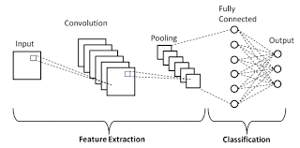

Slide 19
b.VGG16
VGG-16 is a convolutional neural network that is 16 layers deep.
A pretrained version of the network trained on more than a million images from the ImageNet database.
The pretrained network can classify images into 1000 object categories, such as keyboard, mouse, pencil, and many animals.

Slide 20
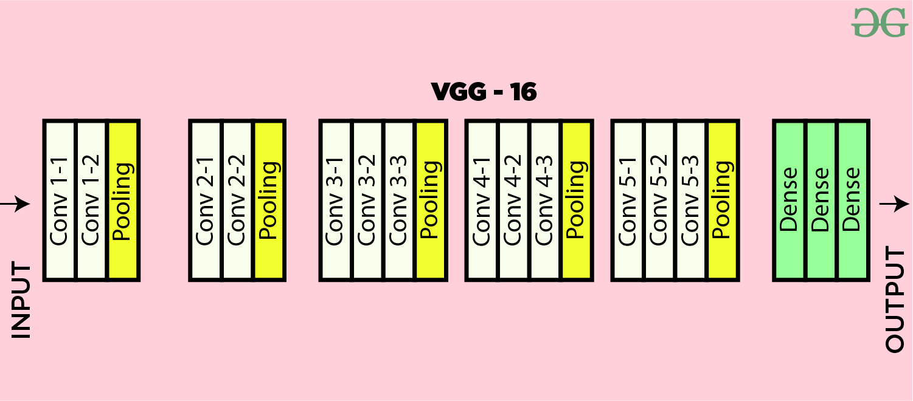

Slide 21
c.VGG19
VGG-19 is a convolutional neural network that is 19 layers deep (16 convolution layers, 3 Fully connected layer, 5 MaxPool layers and 1 SoftMax layer).
A pretrained version of the network trained on more than a million images from the ImageNet database.
The pretrained network can classify images into 1000 object categories.
As a result, the network has learned rich feature representations for a wide range of images.
The network has an image input size of 224-by-224.

Slide 22
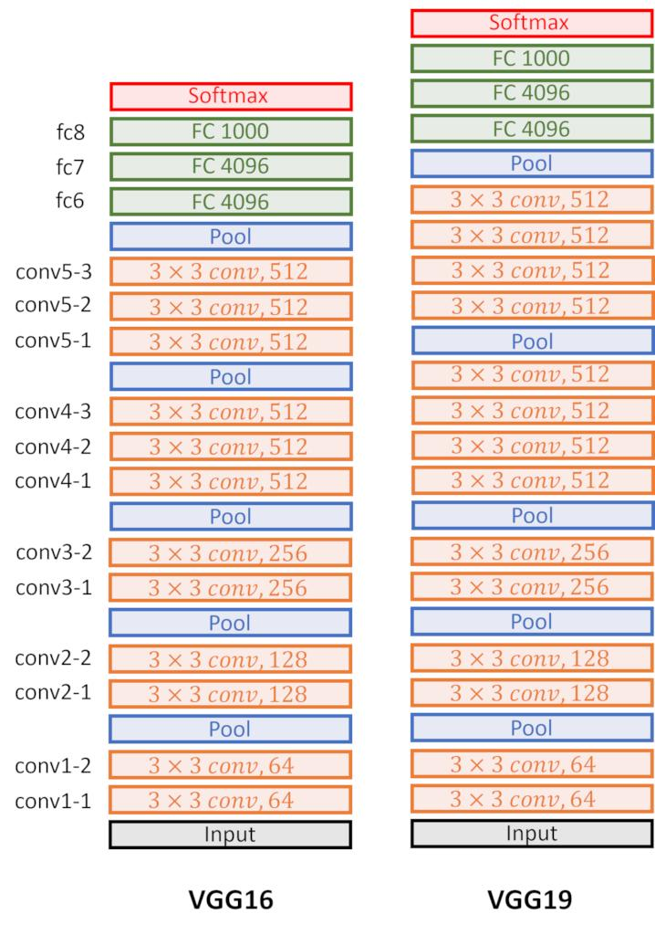

Slide 23
d.YOLOV3
YOLOv3 (You Only Look Once, Version 3) is a real-time object detection algorithm that identifies specific objects in videos, live feeds, or images.
YOLO uses features learned by a deep convolutional neural network to detect an object.
Versions 1-3 of YOLO were created by Joseph Redmon and Ali Farhadi.

Slide 24
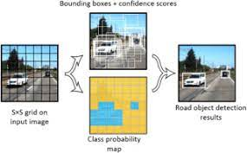

Slide 25
RESULT AND DISCUSSION
Currently, available ANPR systems have a lot of disadvantages.
So, it is important to identify an algorithm that provides more accuracy .
In this project, CNN, Vgg16, vgg19 and Yolov3 are used to find the license plate and comparing the accuracies achieved.
Among these, Vgg16 shows highest accuracy and Vgg19 shows least accuracy.

Slide 26
Table below shows the algorithms and accuracies obtained.
ALGORITHM | ACCURACY(50 EPOCH)
CNN | 77
VGG16 | 89
VGG19 | 49
YOLOV3 | 78

Slide 27
CONCLUSION AND FUTURE ENHANCEMENT
There is an immediate need of such kind of Automatic Number Plate Recognition System in India as there are problems of traffic, Stealing cars etc.
Government should take some interest in developing these kind of systems as this system is very economical and eco-friendly, if applied effectively.

Slide 28
In this project, Vgg16 shows highest accuracy and Yolov3 shows second largest accuracy.
Yolov3 doesn’t depend on the intensity of light.
But VGG 16 shows lower accuracy in poor lighting conditions as compared to Yolov3.
So developing a system that switches algorithms automatically between yolov3 and vgg16 according to the light intensity would result in a more efficient ALPR system.

Slide 29
REFERENCES
Lubna, Naveed Mufti, and Syed Afaq Ali Shah –” Automatic Number Plate Recognition:A Detailed Survey of Relevant Algorithms “-Peshawar 25000, Pakistan; Lubnaxafi@gmail.com 2 Department of Telecommunication Engineering, University of Engineering and Technology, Mardan 23200, Pakistan 3 Department of Information Technology, Media and Communications, Murdoch University, Murdoch 6150, Australia; Afaq.Shah@murdoch.edu.au * Correspondence: Naveed@uetmardan.edu.pk-26 April 2021.
CHRIS HENRY , SUNG YOON AHN , AND SANG-WOONG LEE – “Multinational License Plate Recognition Using Generalized Character Sequence Detection”- Pattern Recognition and Machine Learning Laboratory, Gachon University, Seongnam 13557, South Korea, February 28, 2020.
Samiul Azam a,b,⇑ , Md Monirul Islam- ”Automatic license plate detection in hazardous condition” -Department of Computer Science, University of Calgary, Calgary, Alberta, Canada bDepartment of Computer Science and Engineering, Bangladesh University of Engineering and Technology, Dhaka, Bangladesh-6 February 2018

Slide 30
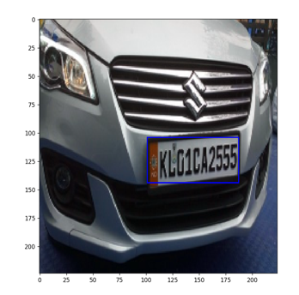
SCREENSHOTS
CNN

Slide 31
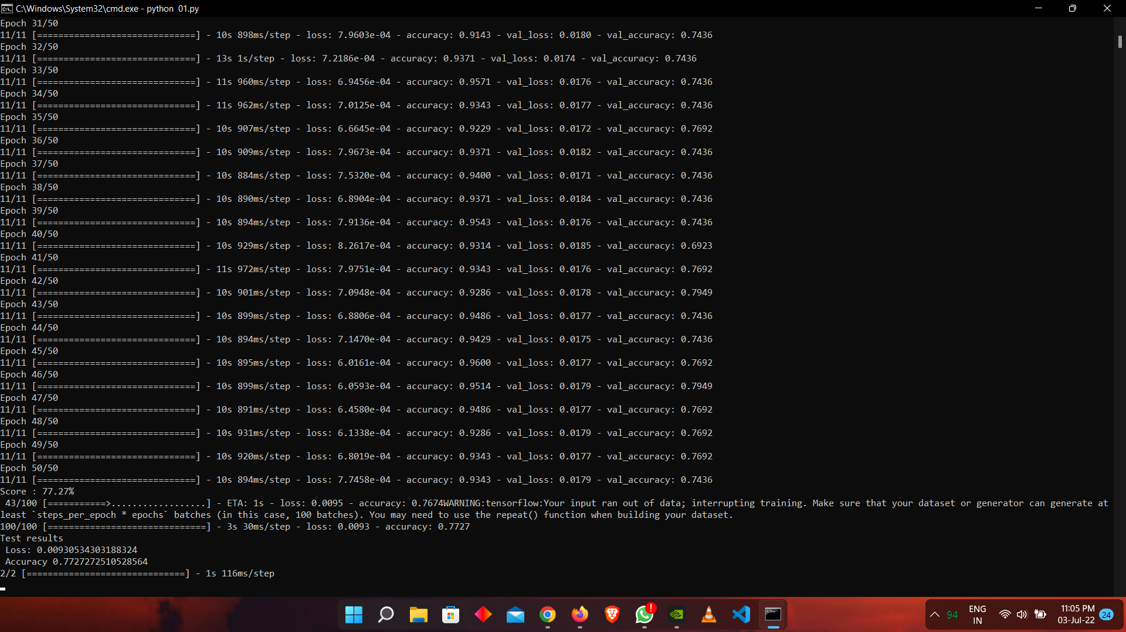

Slide 32
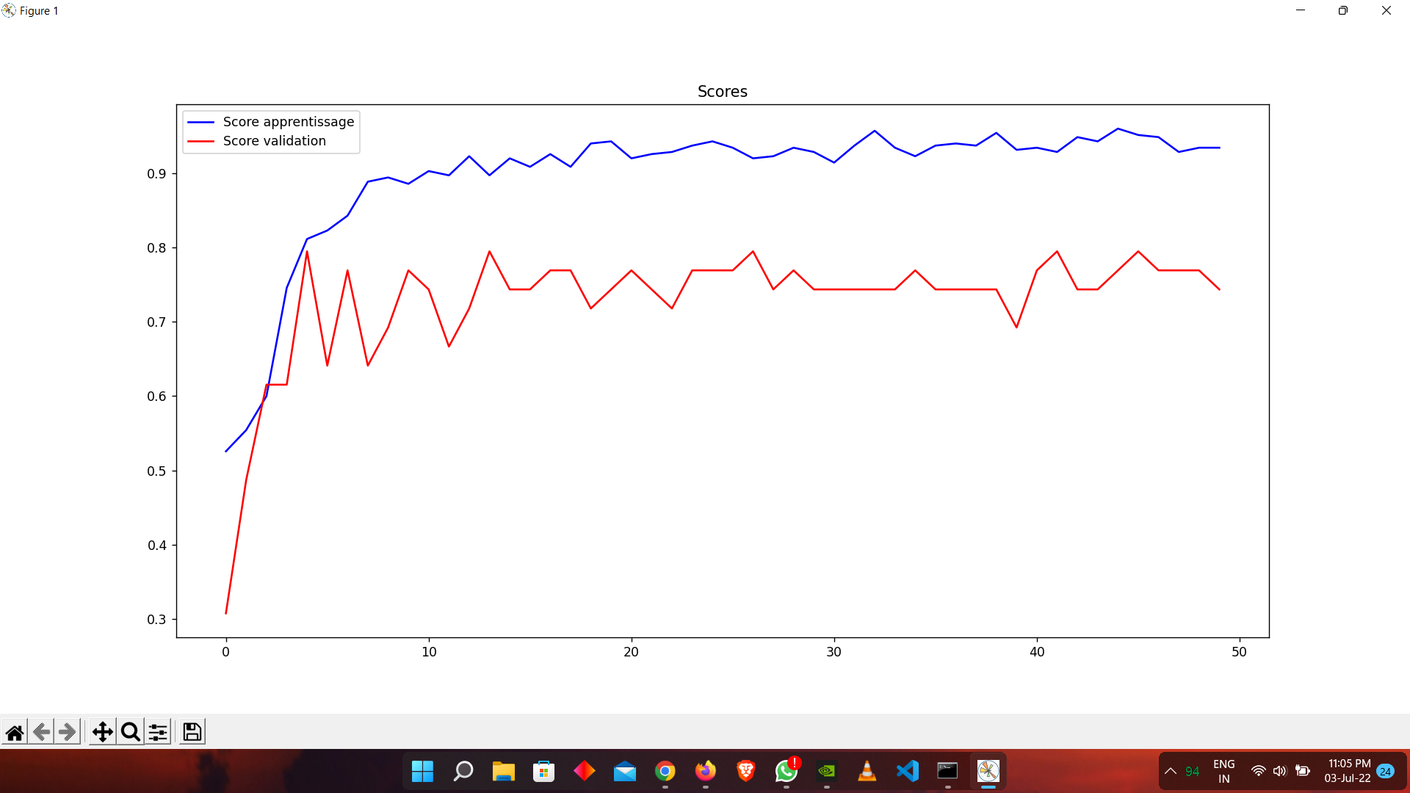

Slide 33
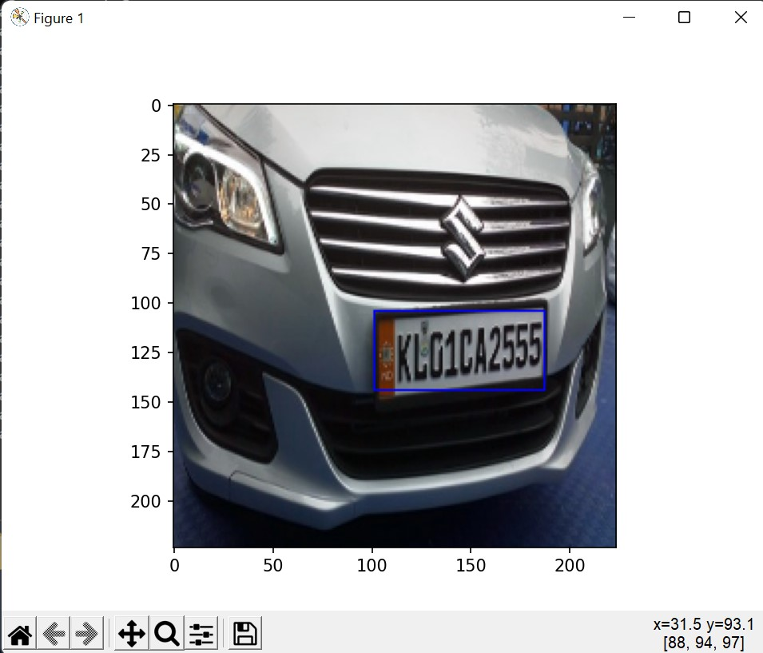
VGG16

Slide 34
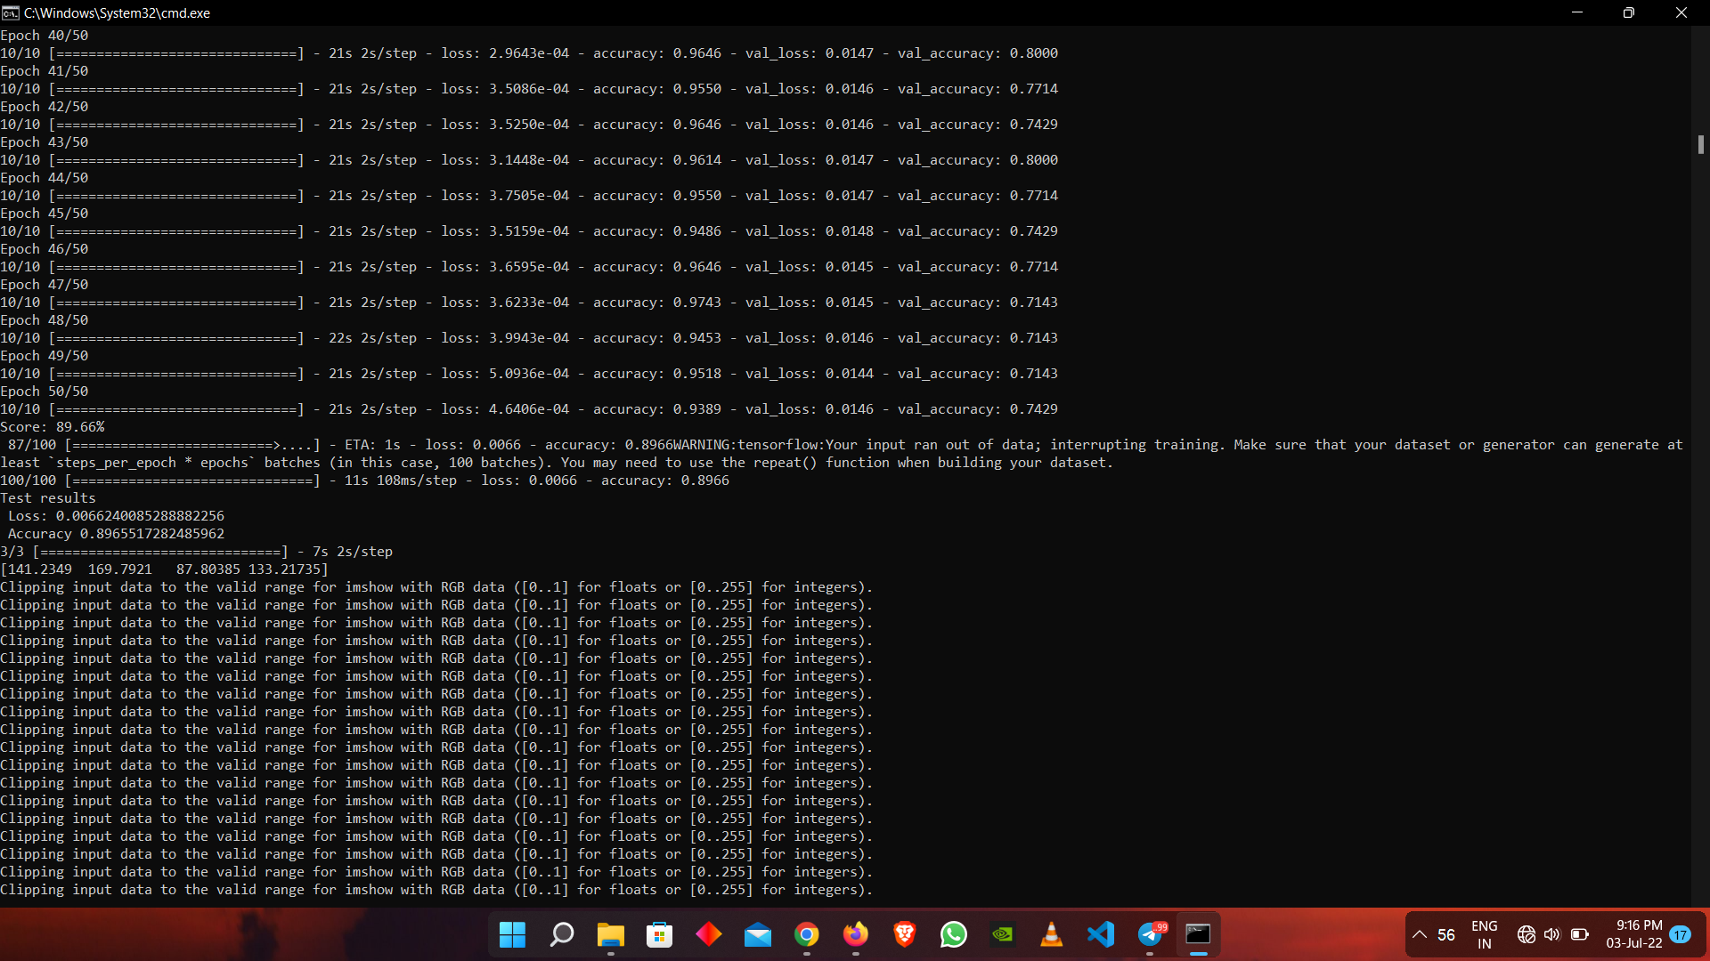

Slide 35
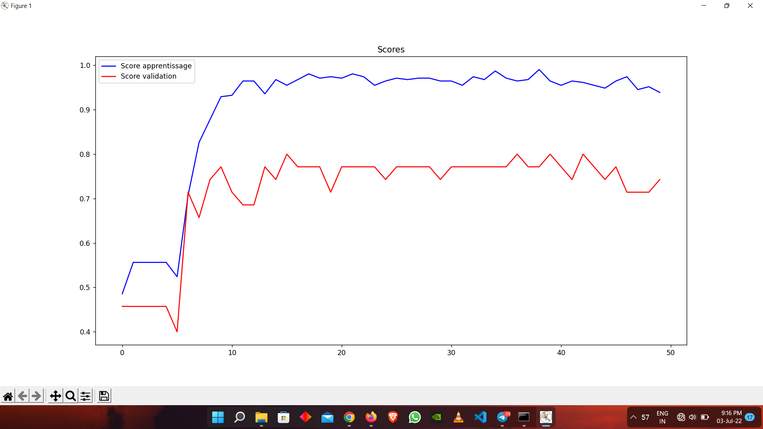

Slide 36
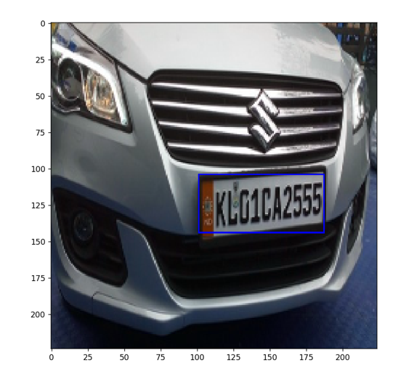
VGG19

Slide 37
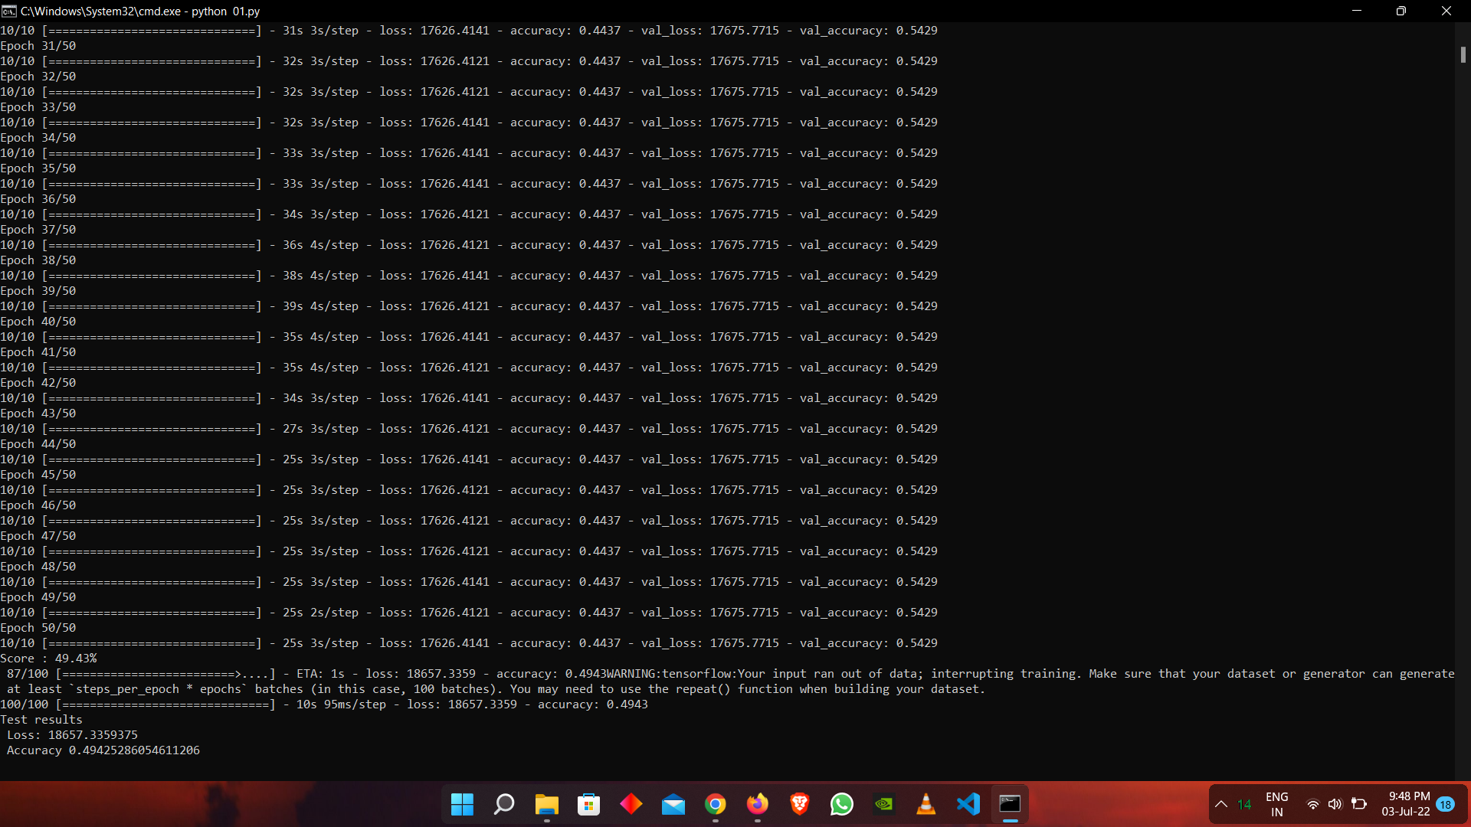

Slide 38
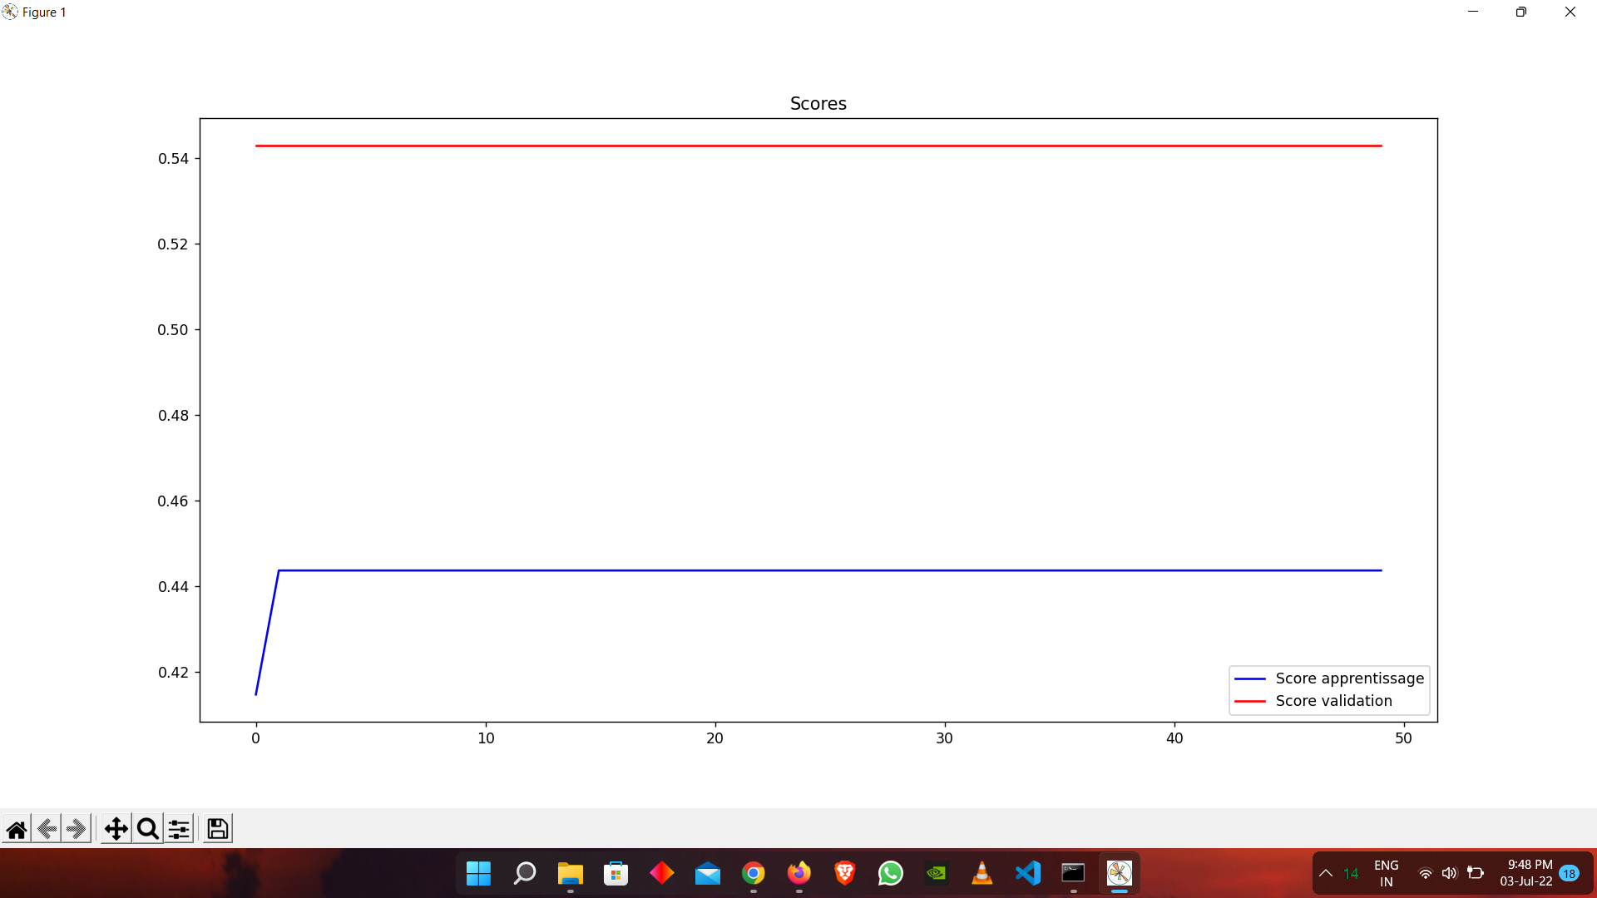

Slide 39
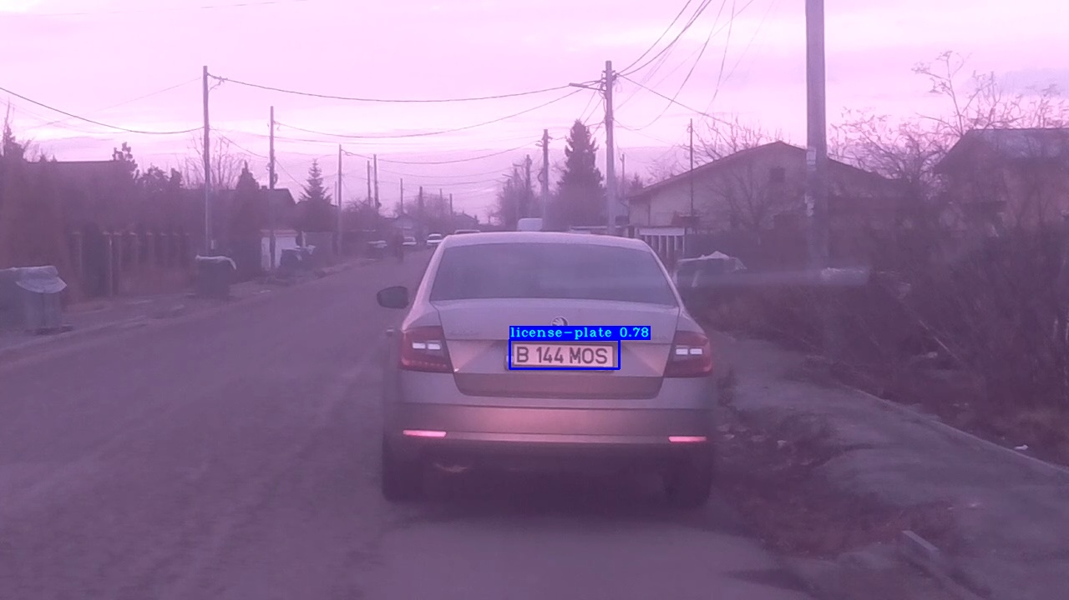
YOLOV3

Slide 40
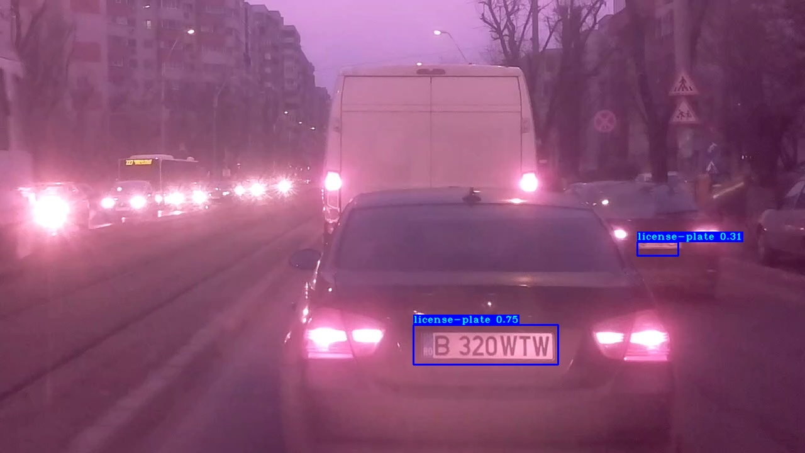
YOLOV3

Slide 41
THANK YOU!!!

